Slide 1
Member Enrollment, Eligibility, Termination and Benefits

Slide 2
Who is Subscriber & Member
Who is a subscriber?
A subscriber is the person or organization who subscribes to the insurance
In other terms, it is the policy holder who pays for the insurance premiums
The person or organization who has the policy and all credentials on their name
Responsible for all the billings
Who is Member?
Anyone who is enrolled in health plan. It includes dependents as well as subscribers
All the subscribers are members but not all the members are subscribers
Note : Membership refers to health insurance contract that exist between the member and their chosen health plan/fund

Slide 3
Member Enrollment
Member Enrollment:
The Process by which a health plan signs up individual or groups as subscribers
It is the process of adding eligible individuals to healthcare benefit
To be eligible for covered benefits , services and supplies one must be enrolled as a member
Types of Enrollees
Subscribers
Dependent
Domestic Partners
Note :
Subscriber’s grandchildren is not eligible
Domestic partner’s children are Eligible

Slide 4

Dates for Member Enrollment

Slide 5
Membership Services
Membership ID Cards:
Identity card represents the eligibility of the member with the Insurance Company
Before Providers give out treatment, they require these ID cards from member for validation purposes
Premium Billing/Premium Details :
The Consideration paid by the insured to the insurer for making getting an insurance cover
Depends on many factors like location, age, sex, pre-existing condition etc.
Benefits:
Benefits are the contractual pay-out or services agreed by the insurer for the policyholder, which are provided under stated circumstances under the terms of an Insurance Policy
Will Discuss about Benefits in Later half of the session

Slide 6
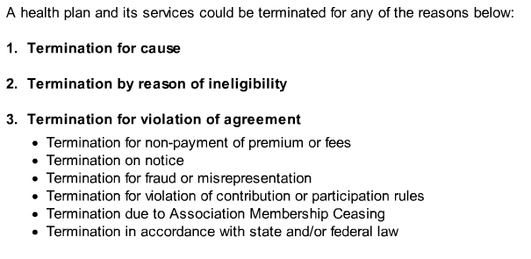
Termination of Membership Services

Slide 7
Introduction to Benefits
Benefits :
Benefits refers to specific areas of a plan’s coverage (Outpatient visits, hospitalization etc.), that make up the range of medical services that a payer markets to its subscribers. Also, a contractual agreement, specified in an evidence of coverage, determining covered services provided by insurers to members
Benefit Package:
A Benefit package refers to aggregate services specifically defined by an insurance policy that can be provided to patients. The services a payer offers to a group or individual. The Package will specify cost, limitation on the amounts of services, and annual or life time spending limits
Benefit Design :
Benefit Design refers to the process a Managed Care Organization(MCO) uses to determine which benefits or the level of benefits that will be offered to its members, the degree to which members will be expected to share the costs of such benefits, and how member can access medical care through the plan
Benefit Period:
It is the length of time during which a benefit is paid. It can be Calendar year or Plan year.

Slide 8
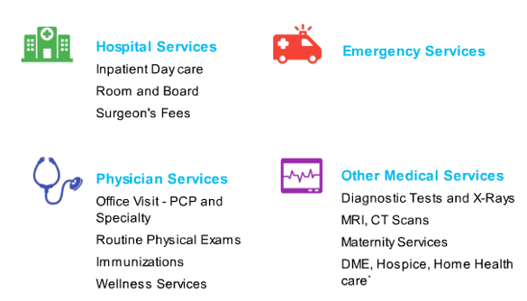
Commonly Covered Benefits

Slide 9

Commonly Not Covered Benefits

Slide 10
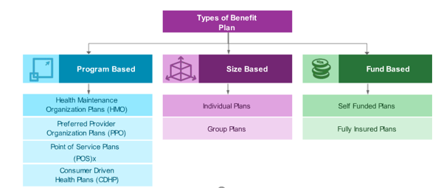
Introduction to Types of Benefit Plans

Slide 11

Types of Plans

Slide 12

Regulatory Impacts on Plans

Slide 13
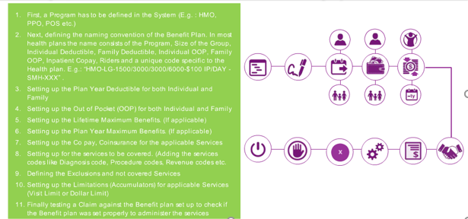
Setting Up a Benefit Plan

Slide 14
Setting Up a Benefit Plan
First a program has to be defined in the system(Ex. HMO, PPO, POS etc.)
Next, define the naming convention of the Benefit Plan. In most health plans the name consists of the Program, Size of the Group, Individual Deductible, Family Deductible, Individual OOP, Family OOP, Inpatient Copay, Riders and unique code specific to the Health Plan.
Ex: “HMO-LG-1500/3000/3000/6000-$100IP/Day-SMH-XXX”
Setting up the plan year Deductible for both Individual & Family
Setting up the Out of Pocket for both Individual & Family
Setting up the Life Time Maximum Benefits
Setting up the Plan Year Maximum Benefits
Setting up the Copay, Coinsurance for the applicable services
Setting up the services to be covered.(Adding the services codes like diagnosis codes, procedure codes, revenue codes etc.)
Defining the exclusions and not covered Services

Slide 15
Setting Up a Benefit Plan
Setting up the Limitations(Accumulators) for applicable Services (Visit Limit or Dollar Limit)
Finally testing a claim against the Benefit Plan setup to check if the Benefit Plan was set properly to administer the services
Explanation of Coverage:
An Explanation of coverage, also known as an Evidence of Coverage, is the list of detailed information of all the benefits the member entitled for, such as benefits administration, coverage limits, annual limits, dependent coverage information, exclusion and limitations, co pay, deductibles, covered and not covered benefits etc.
An Explanation of Coverage is for a particular calendar period. The Contract and coverage may differ from different periods. The EOC also covers information about the prescription drug benefits, inpatient and out-patient coverage details

